Slide 1
Constructing Max Plus TCP Matrices
Waylon Jepsen

Slide 2
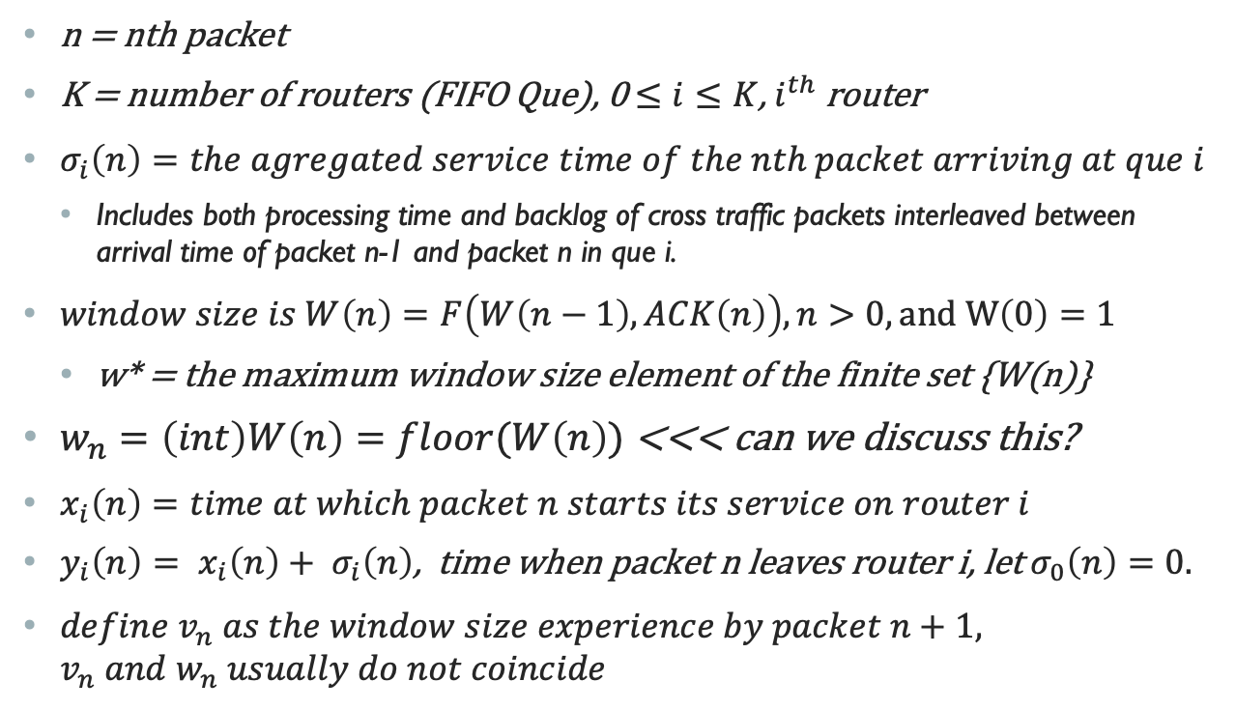
Definitions
n = nth packet
K = number of routers (FIFO Que), 0 $≤i≤K$, $i^{th}$ router
$σ_{i}\left(n\right)=the agregated service time of the nth packet arriving at que i$
Includes both processing time and backlog of cross traffic packets interleaved between arrival time of packet n-1 and packet n in que i.
$window size is W\left(n\right)=F\left(W\left(n−1\right),ACK\left(n\right)\right), n>0, and W\left(0\right)=1$
w* = the maximum window size element of the finite set {W(n)}
$w_{n}=\left(int\right)W\left(n\right)=floor(W\left(n\right))$ <<< can we discuss this?
$x_{i}\left(n\right)=time at which packet n starts its service on router i$
$y_{i}\left(n\right)= x_{i}\left(n\right)+ σ_{i}\left(n\right)$, time when packet n leaves router i, let $σ_{0}\left(n\right)=0.$
${define v}_{n} as the window size experience by packet n+1, v_{n} and w_{n} usually do not coincide$

Slide 3
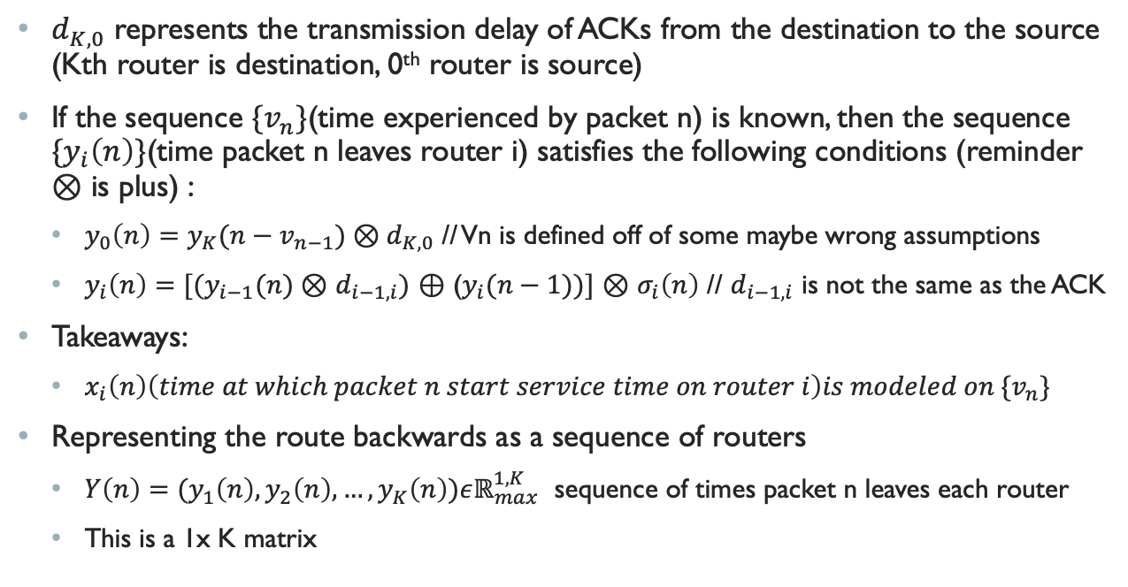
Continued
$d_{K,0}$ represents the transmission delay of ACKs from the destination to the source (Kth router is destination, 0th router is source)
If the sequence ${\{v}_{n}\}$(time experienced by packet n) is known, then the sequence ${\{y}_{i}\left(n\right)\}$(time packet n leaves router i) satisfies the following conditions (reminder $⊗$ is plus) :
$y_{0}\left(n\right)=y_{K}(n−v_{n−1})⊗d_{K,0}$ // Vn is defined off of some maybe wrong assumptions
$y_{i}\left(n\right)=[(y_{i−1}(n)⊗$ $d_{i−1,i})$ $⊕$ ($y_{i}(n−1))]$ $⊗$ $σ_{i}\left(n\right)$ // $d_{i−1,i}$ is not the same as the ACK
Takeaways:
$x_{i}\left(n\right)\left(time at which packet n start service time on router i\right)is modeled on {\{v}_{n}\}$
Representing the route backwards as a sequence of routers
$Y\left(n\right)=(y_{1}\left(n\right),y_{2}\left(n\right),…,y_{K}\left(n\right))εℝ_{max}^{1,K}$ sequence of times packet n leaves each router
This is a 1x K matrix

Slide 4
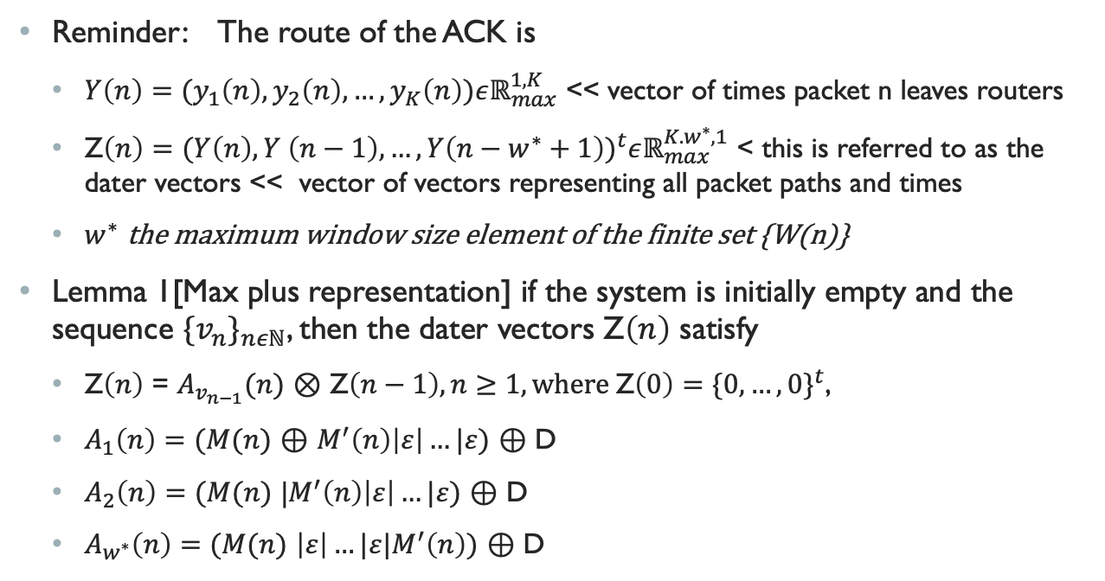
Making Max Plus Matrices
Reminder: The route of the ACK is
$Y\left(n\right)=(y_{1}\left(n\right),y_{2}\left(n\right),…,y_{K}\left(n\right))εℝ_{max}^{1,K}$ << vector of times packet n leaves routers
Z$\left(n\right)={(Y\left(n\right),Y \left(n−1\right),…,Y\left(n−w^{∗}+1\right))}^{t}εℝ_{max}^{K.w^{∗},1}$ < this is referred to as the dater vectors << vector of vectors representing all packet paths and times
$w^{∗}$ the maximum window size element of the finite set {W(n)}
Lemma 1[Max plus representation] if the system is initially empty and the sequence ${{\{v}_{n}\}}_{nεℕ}$, then the dater vectors Z$\left(n\right)$ satisfy
Z$\left(n\right)$ = $A_{v_{n−1}}(n)$ $⊗$ Z$\left(n−1\right), n≥1, where \text{Z}\left(0\right)={\{0,…,0\}}^{t}$,
$A_{1}\left(n\right)=(M(n)$ $⊕$ $M^{′}\left(n\right)\left|ε\right|…|ε)$ $⊕$ D
$A_{2}\left(n\right)=(M(n)$ |$M^{′}\left(n\right)\left|ε\right|…|ε)$ $⊕$ D
$A_{w^{∗}}\left(n\right)=(M(n)$ $\left|ε\right|…|ε|M^{′}\left(n\right))$ $⊕$ D

Slide 5
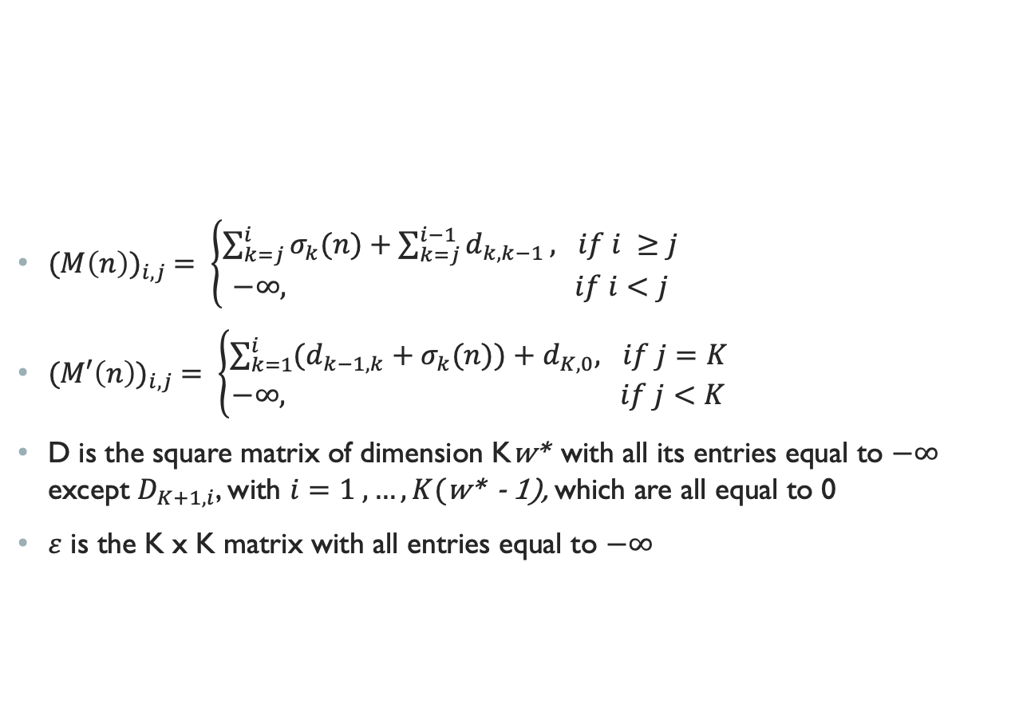
M and M’
${(M\left(n\right))}_{i,j} = \left\{\begin{aligned}\sum_{k=j}^{i}{σ_{k}(n)}+\sum_{k=j}^{i−1}{d_{k,k−1}}, if i ≥j \\ −∞, if i<j\end{aligned}\right.$
${(M′\left(n\right))}_{i,j} = \left\{\begin{aligned}\sum_{k=1}^{i}{(d_{k−1,k}}+σ_{k}(n))+d_{K,0}, if j=K \\ −∞, if j<K\end{aligned}\right.$
D is the square matrix of dimension Kw* with all its entries equal to $−∞$ except $D_{K+1,i}$, with $i=1 ,…, K($w* - 1), which are all equal to 0
$ε$ is the K x K matrix with all entries equal to $−∞$

Slide 6
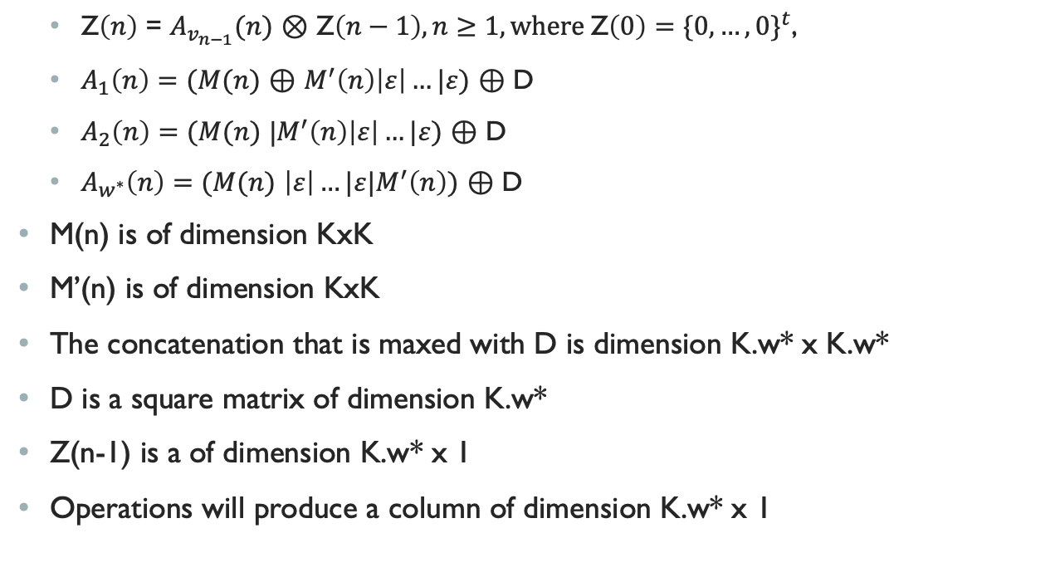
Dimensionalities
Z$\left(n\right)$ = $A_{v_{n−1}}(n)$ $⊗$ Z$\left(n−1\right), n≥1, where \text{Z}\left(0\right)={\{0,…,0\}}^{t}$,
$A_{1}\left(n\right)=(M(n)$ $⊕$ $M^{′}\left(n\right)\left|ε\right|…|ε)$ $⊕$ D
$A_{2}\left(n\right)=(M(n)$ |$M^{′}\left(n\right)\left|ε\right|…|ε)$ $⊕$ D
$A_{w^{∗}}\left(n\right)=(M(n)$ $\left|ε\right|…|ε|M^{′}\left(n\right))$ $⊕$ D
M(n) is of dimension KxK
M’(n) is of dimension KxK
The concatenation that is maxed with D is dimension K.w* x K.w*
D is a square matrix of dimension K.w*
Z(n-1) is a of dimension K.w* x 1
Operations will produce a column of dimension K.w* x 1

Slide 7
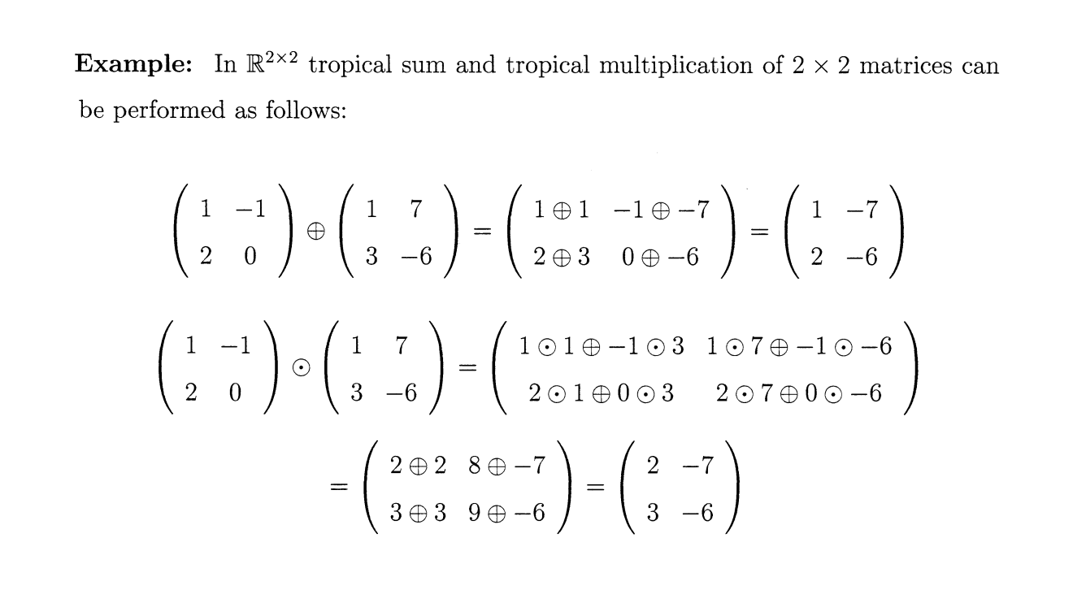
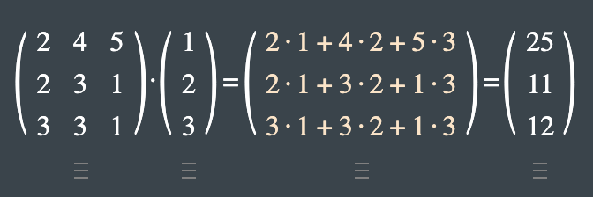
Examples
In Regular Algebra

